Slide 1
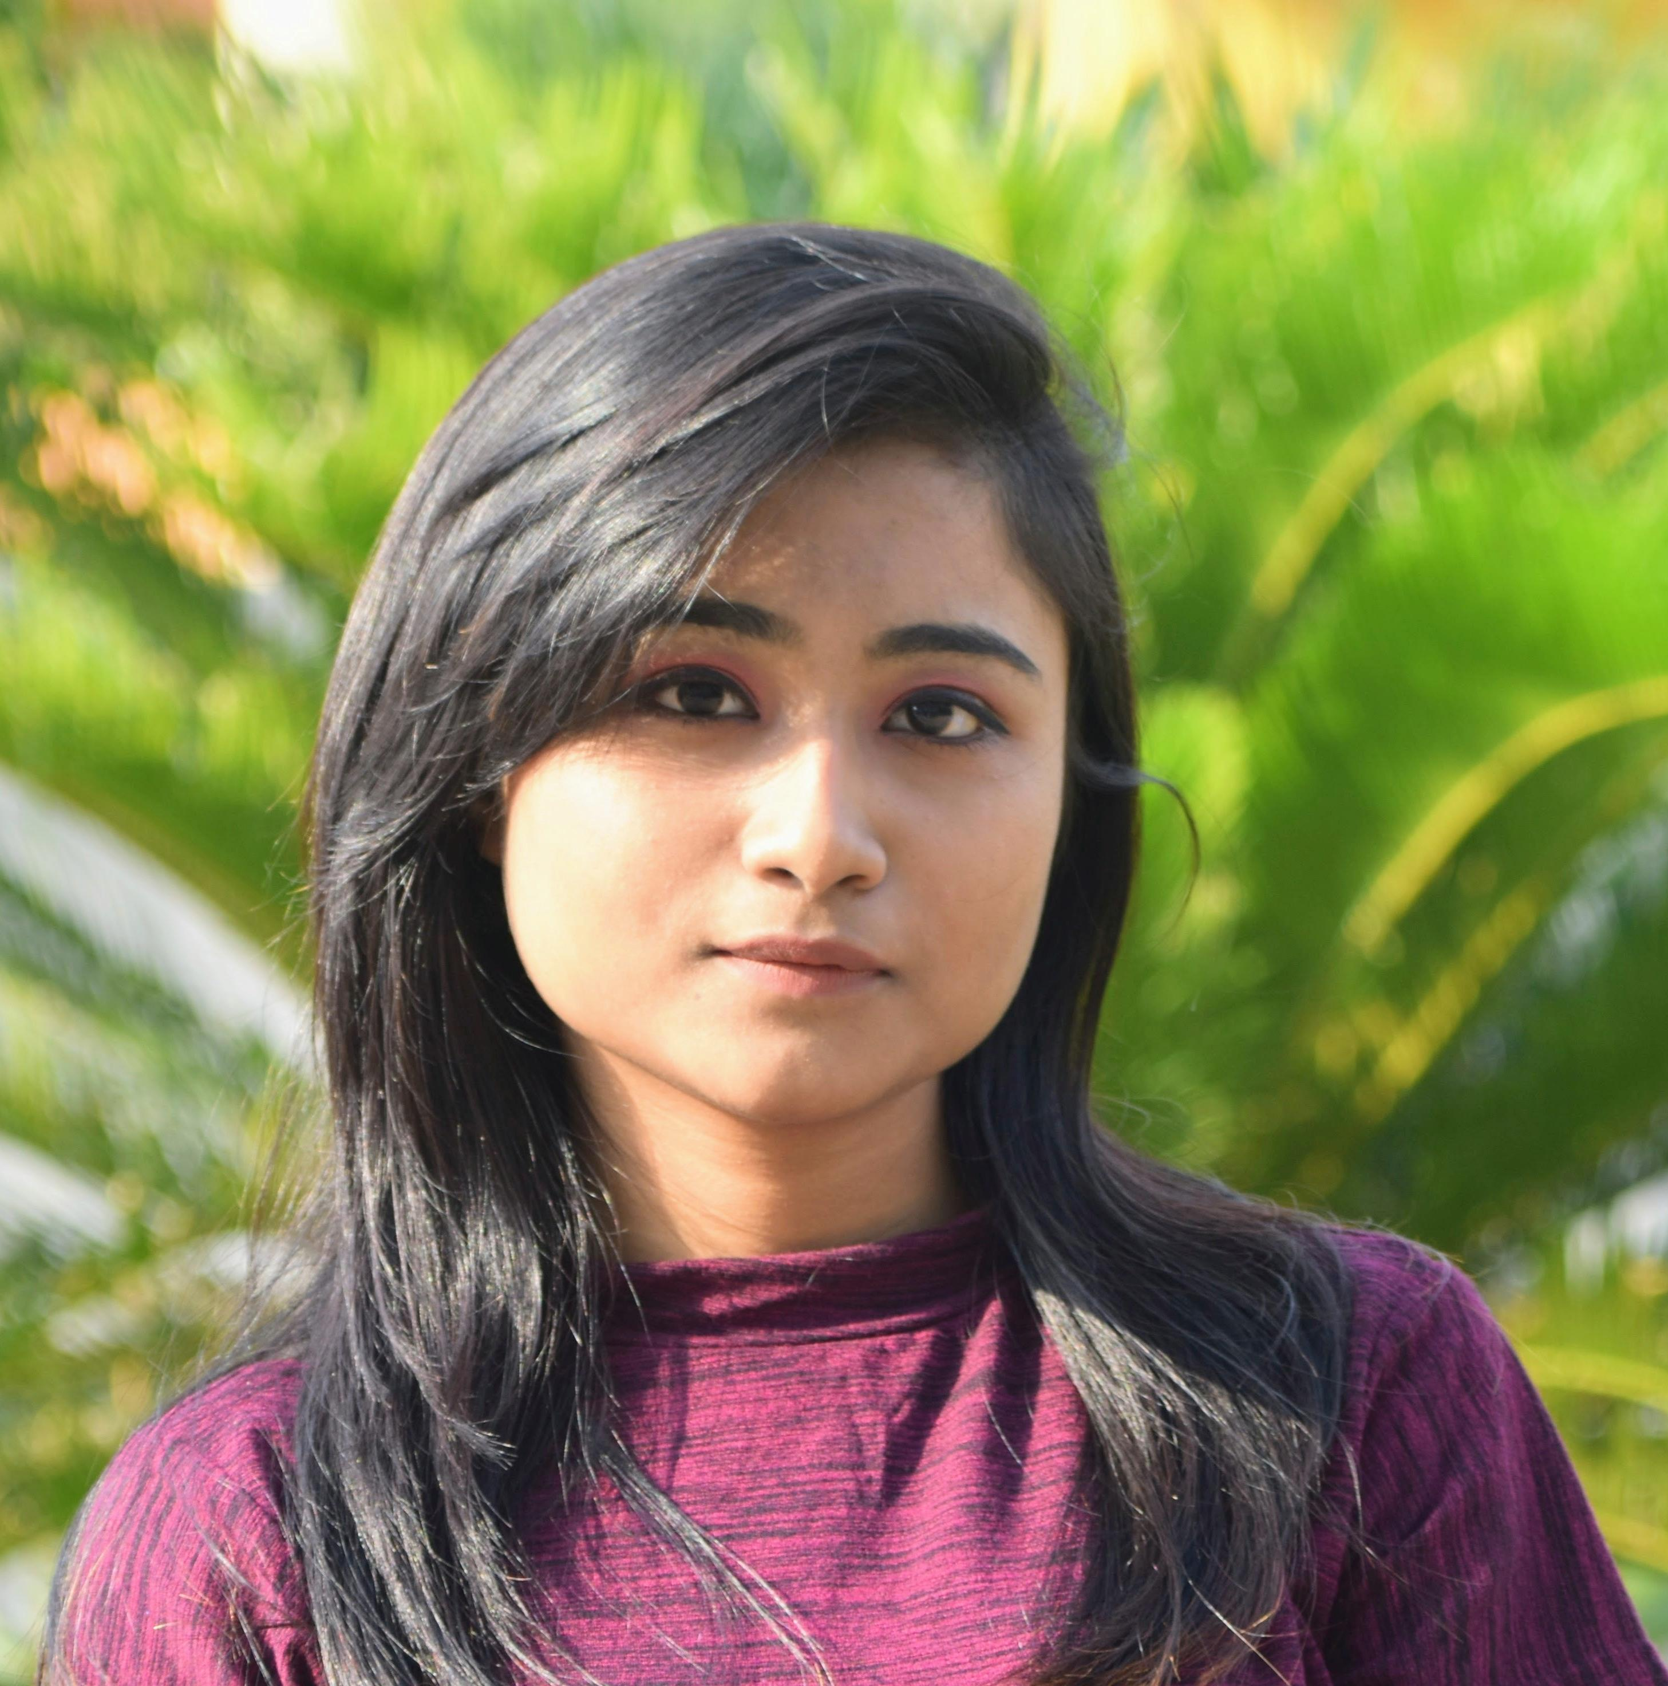

Riyanka Ghosh
Analyst/Software Engineer
Bachelor of Engineering
Computer Science : 2017 - 2021
Skills Java 8
Spring Boot
Spring Boot JPA
Bootstrap
Jest in UI testing
Java Full Stack
Java(Core)
Spring Data JPA
Postman in MS testing
ReactJS
Database
SQL database –PostgreSQL
Web Technologies
HTML5
CSS3
JavaScript
Bootstrap
React
Add-Ons
SonarQube
Additional Details
Enthusiastic
Good Communication Skills
Adapatable, Quick learner
Mumbai
riyanka.c.ghosh@capgemini.com
+91 7596956602
A4
Self-motivated, hardworking software engineer who has the capacity to quickly adapt to the new things in which placed, and how to make a useful resource of it.
Enthusiast to learn new technologies make usage of them to replenish my skills and my knowledge.
Eager to work in a team of dedicated people and serve a key role in the enhancement and development of the project.
Has worked on Darden project . Created the structures of the given user stories and components, did the styling of the user stories as per the requirements and solved bugs as well.
Currently working in Smart Ui builder project. Where we are given an application to build accordingly, manually with assigned technology which is react with bootstrap 5. Later on, generating the same application by using the Smart Ui Builder tool, and modifying accordingly.
Employee Management System
Built an Employee Management system, which is used to manage data related employees, where employee can login and check their data. The organization can also update the data as required. The technologies used to build here is Spring Data JPA, ReactJS for the frontend part, Spring boot for the backend and the database used here is PostgreSQL.
Darden_POS Upgradation
Worked as a frontend developer (React) where created user structures of the given user stories and components. Styling of the user stories as per the requirements and solving bugs. The technologies used here is React for the UI part, Postman an API platform to design build test and iterate APIs. Jest for the UI testing and Spring boot for the microservice (Backend)
Completed the Capgemini ADAPT JAVA Full Stack React Training
AWS Certified Cloud Practitioner

